Slide 1
Civil Right {Important} Court Cases
Unit 10: Civil Rights #4

Slide 2
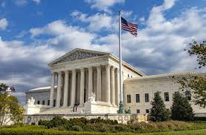
Things To Consider…
The main power of the Supreme Court of the United States is that it can declare laws and acts of the President & Congress unconstitutional
Do you think the Supreme Court should have this power?
Why or why not?

Slide 3
Supreme Court Cases
Supreme Court, led by the Chief Justice Earl Warren, had an active role during Johnson’s presidency in reshaping America
Supreme Court Cases:
Plessy v. Ferguson (1896): separate but equal
Brown v. Board of Education (1954): ended segregation in schools, overturned Plessy v. Ferguson
Gideon v. Wainwright: required courts to provide lawyers for defendants who could not afford them
Other Supreme Court Cases:
Escobedo v. Illinois: right to a lawyer present when questioned
Mapp v. Ohio: evidence seized illegally can’t be used in court
United States v. Robinson (1973): reasonable search
What about today’s digital age/cell phones?
Riley v. California (2014): unanimously ruled police need warrants to search the cellphones of people they arrest

Slide 4
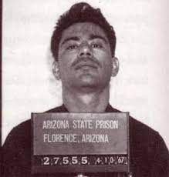
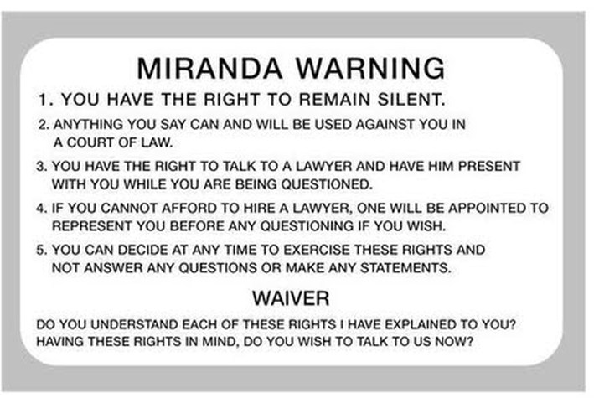
Miranda v. Arizona
Supreme Court case established that people being accused must be informed of their rights (5th amendment) before being charged with a crime

Slide 5
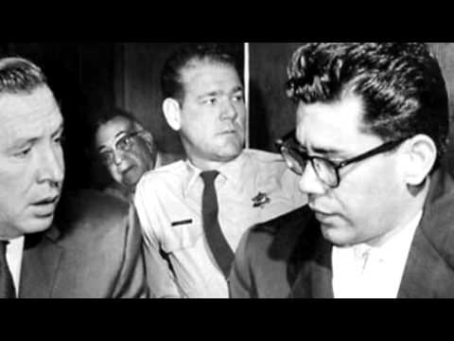

Slide 7
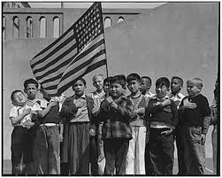
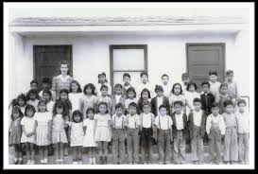
School Segregation & Unfairness
Mendez v. Westminster ISD (1947)
Delgado v. Bastrop ISD (1948)
Edgewood ISD v. Kirby (1984)
In the Mendez & Delgado cases, the courts ruled that school districts could not segregate if there wasn’t a state segregation law already (this was before Brown v. Board)
In Edgewater, the Supreme Court ruled that states had to fund poor and rich school districts equally
In each of these cases, courts ruled against racial unfairness and segregation in public schools

Slide 8
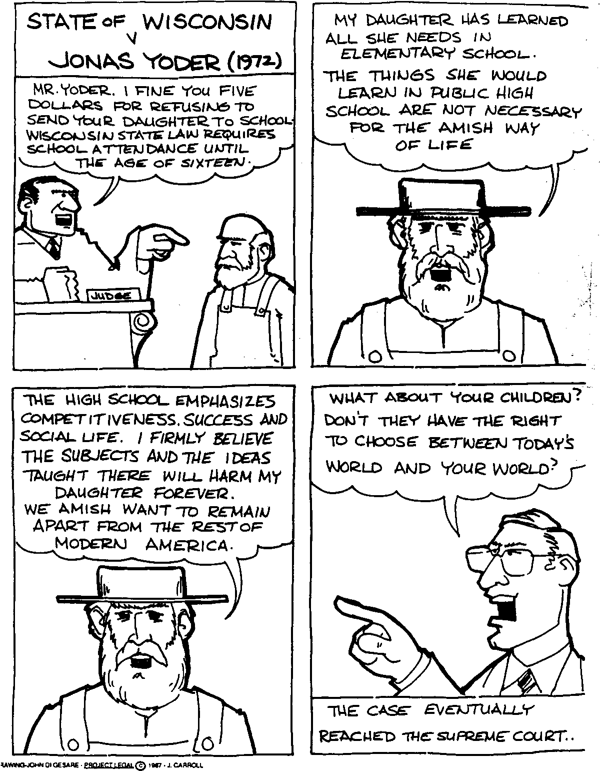
Wisconsin v. Yoder (1971)
In 1971, the Supreme Court ruled that Wisconsin could not force Amish children to go to school after the 8th grade
The court ruled that states cannot force children to attend school if it conflicts with their freedom of religion

Slide 9
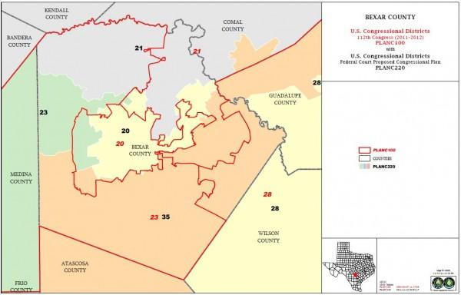
White v. Regester (1973)
In 1970, Texas changed the boundaries for its legislature districts so that blacks and Hispanics in San Antonio & Dallas would have very little chance of getting elected
The Supreme Court said that states could not discriminate by redistricting (changing voting boundaries)
The Texas legislature attempted a similar redistricting in 2012 but was denied by the Federal Election Commission

Slide 10
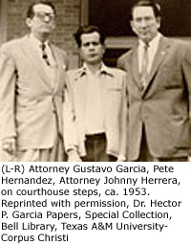
Hernandez v. Texas (1954)
Because Mexican-Americans are considered “white” by the U.S. census, southern states such as Texas had always given Hispanic defendants all white juries in court cases
After Pete Hernandez was convicted of murder and sentenced to death by an all-white jury, he appealed
The Supreme Court ruled that Mexican-Americans are a separate class even though the law says that they are white and thus deserve to have Mexican-Americans on their juries
The winning argument was made when Hernandez’s lawyer pointed out that there was a Mexicans-only restroom in the very court that Hernandez was tried in

Slide 11
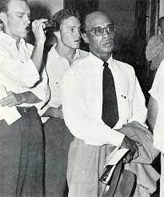
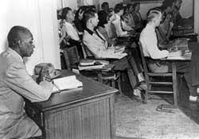
Sweatt v. Painter (1950)
Heman Marion Sweatt, a black man, applied for admission to the University of Texas Law School (1946)
State law restricted access to the university to blacks, Sweatt’s application was automatically rejected because of his race
When Sweatt asked the state courts to order his admission, the university attempted to provide separate but equal facilities for black law students

Slide 12
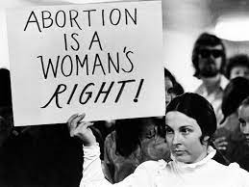
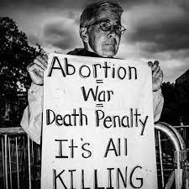
Roe v. Wade (1973)
The debate on abortion is between “pro-life” (people who want to outlaw abortion) and “pro-choice” (people who want abortion to be a legal choice)
In the 1970s, the women’s rights movement rallied around the pro-choice argument
In Roe v. Wade, the Supreme Court ruled that women had the right to choose abortion up to 3 months
Later, she said it was her biggest regret and started fighting to end abortion

Slide 13
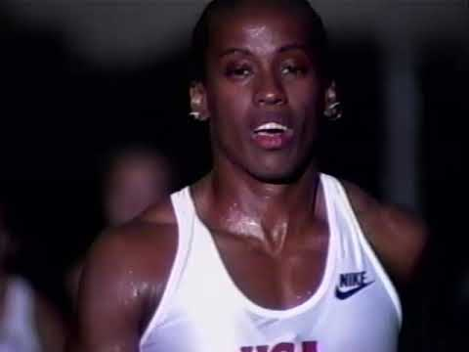

Slide 14
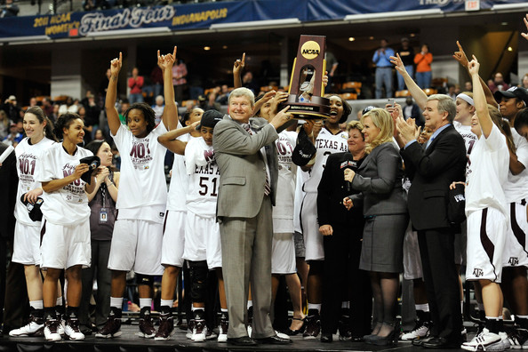
Title IX (Nine)
Title IX of the Educational Amendments Act (1972) promotes equality between boys and girls in education by withholding federal funding from schools and colleges that don’t give equal opportunities to boys and girls
This greatly increased the number of girls’ sports programs and more women were able to go to college for better jobs

Slide 15
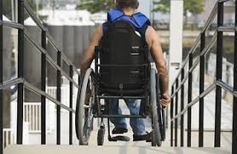
Americans with Disabilities Act (ADA)
Banned discrimination against persons with disabilities in employment, transportation, public education, etc.
Easier access to employment and public facilities

